Slide 1
Tribal Resilience Across the North Central Region
Kynser Wahwahsuck
Tribal Climate Resilience Liaison
Great Plains Tribal Water Alliance
North Central Climate Adaptation Science Center

Slide 2
Presentation Overview
Introduction of myself, and the NC CASC
Tribal Climate Resilience Liaison program
How we can help as Tribal Climate Resilience liaisons

Slide 3
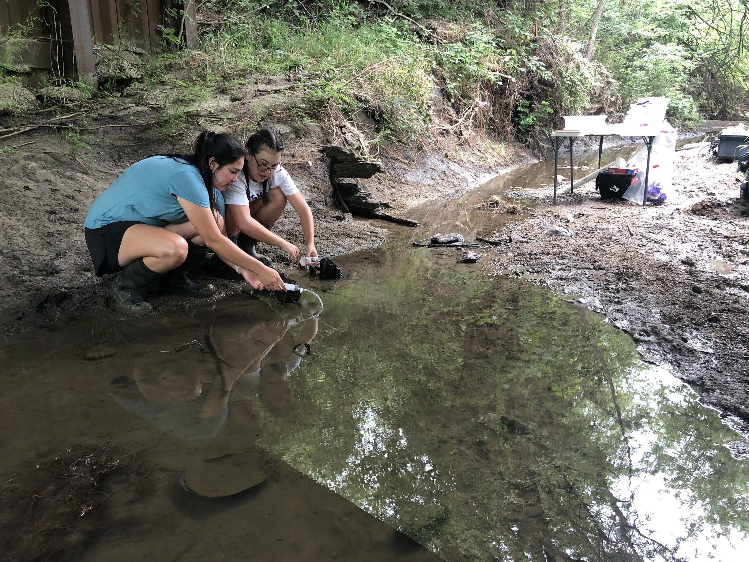
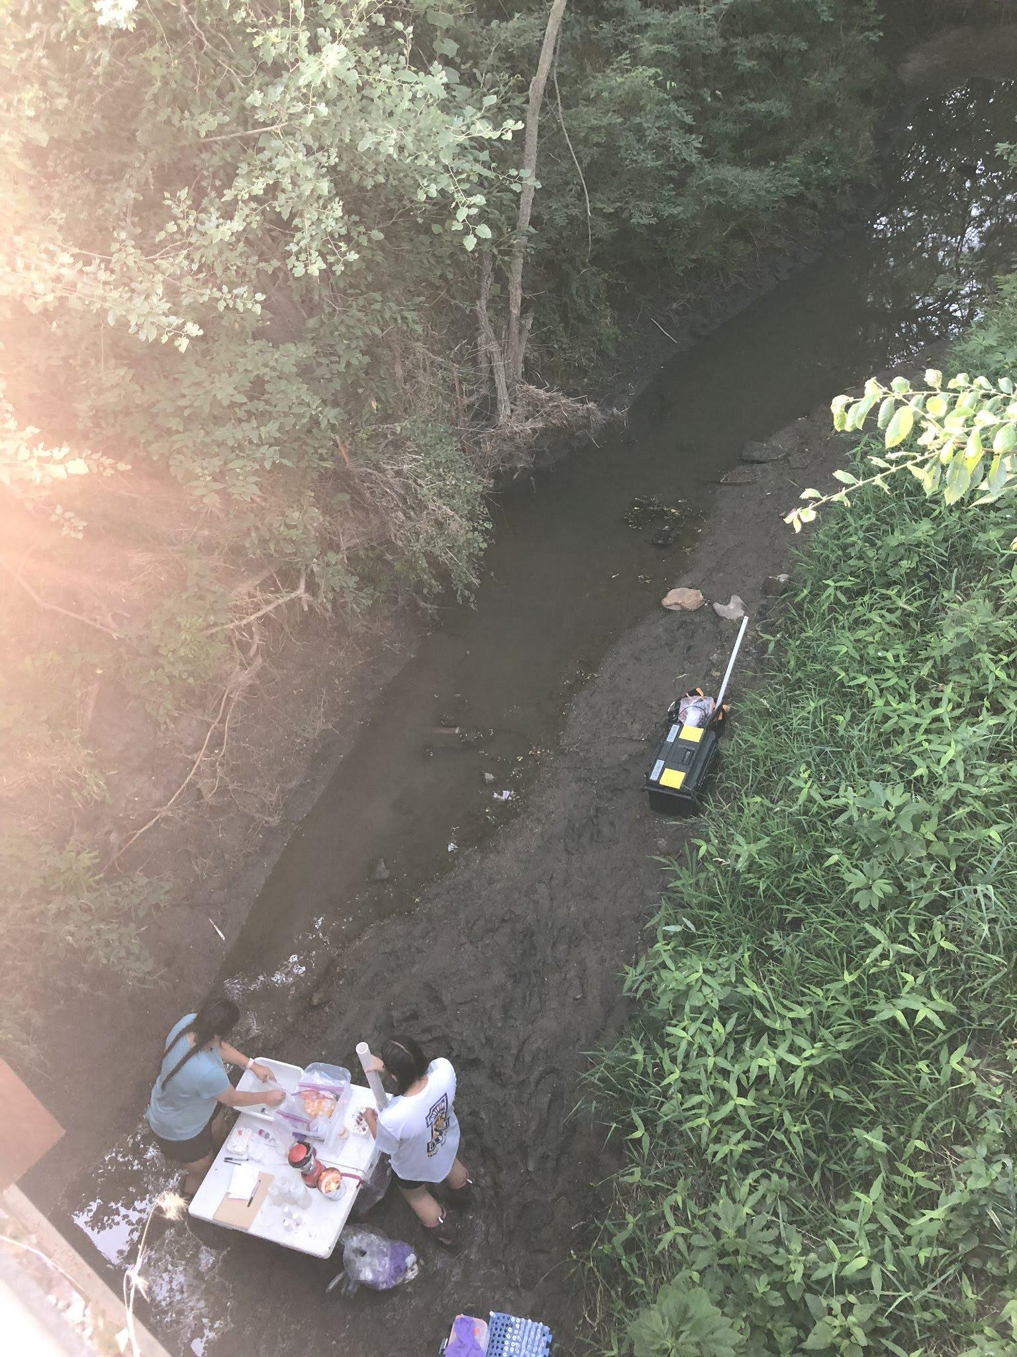
About me
Kynser
Kickapoo Tribe in Kansas, Shoshone, Sac & Fox
Graduated with B.S. Environmental Science from Haskell Indian Nations University
Obtained Master’s in Stream Ecology from The University of Kansas
Research: How does land use affect nitrogen cycling in headwater streams?

Slide 4
Great Plains Tribal Water Alliance
Mission:
The GPTWA is dedicated to protection and preservation of the Great Sioux Nation Indian Winter’s Rights of the use of water in the Missouri River Watershed.
Goals:
Provide recommendations to the Great Plains Tribal Chairmen’s association
Provide Technical support on all water issues in the Great Plains
5 board members representing:
Standing Rock Sioux Tribe
Oglala Sioux Tribe
Rosebud Sioux Tribe
Flandreau Santee Sioux Tribe
Lower Brule Sioux Tribe
Notes:
Emphasize we are inter-tribal non-profit employees, under BIA grant to do cc work

Slide 5
BIA Tribal Climate Resilience Liaison Program
Partnership between tribal organizations (GPTWA), BIA, & USGS
Liaisons work with tribal communities responding to climate change through:
Extension efforts to access data, information, and expertise
Facilitate research
Coordinate forums and information exchange
Goal:
To better understand, communicate, and meet the needs of tribal managers/partners for climate-resilient communities
Notes:
At the end of the day we are here to support you with what your concerns regarding climate change are, what do you NEED, -meet you where you’re at, prioritize your needs/concerns PARTNERSHIP- A FEW PARTNERS IN THIS PROGRAM.. Major funding

Slide 6
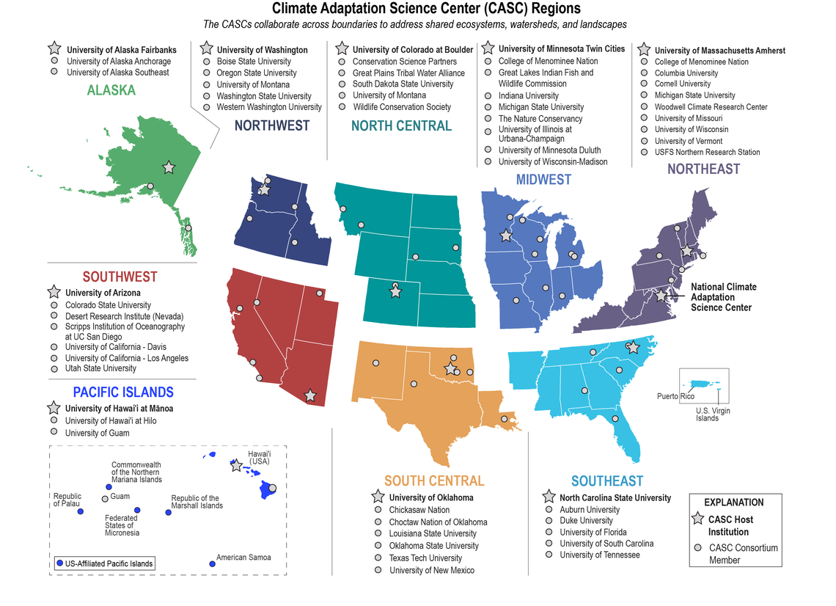
North Central Climate Adaptation Science Center (NC CASC)
Mission:
Work with natural and cultural resource managers to identify, gather, and apply the information they need to understand and adapt to a changing climate
Notes:
Access to scientists funded through NC CASC, SD state climate scientists, CU, SD STATE, UM (consortium partners) but not limited to

Slide 7
Notes:
We play a flexible role, directly under and support federally rec tribes, use others orgs as resources.. Broad range of who we can work with

Slide 8
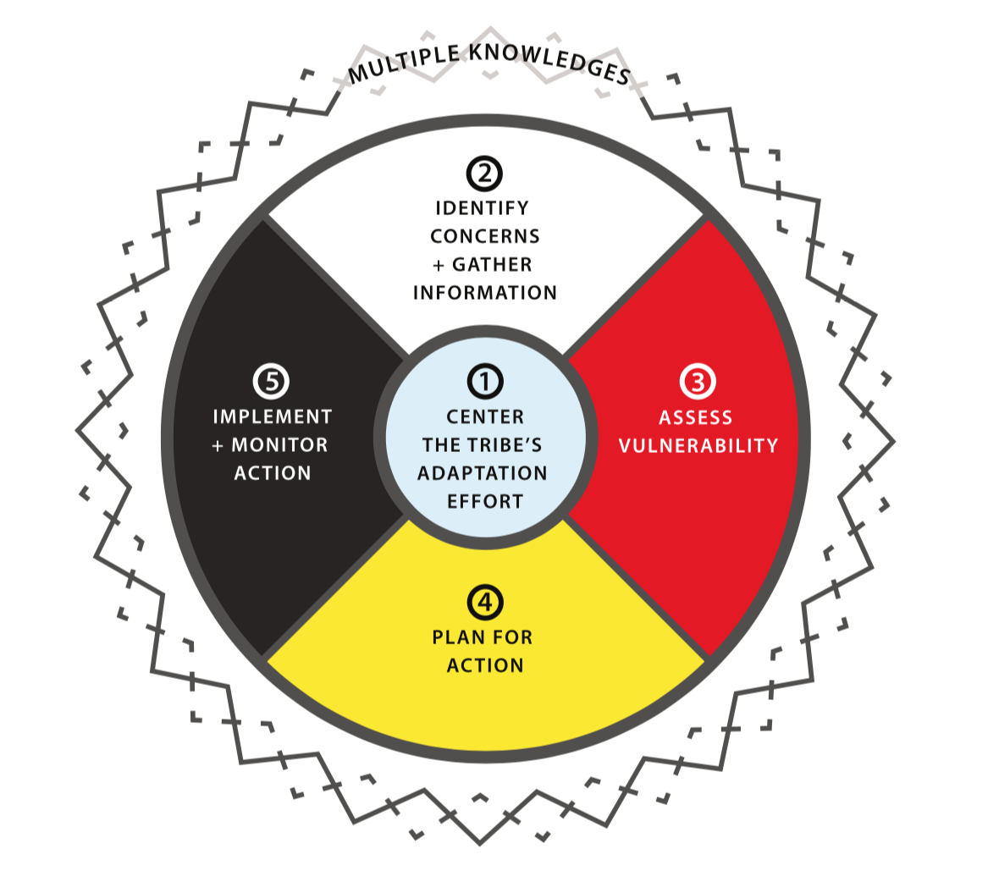
What We Do as Tribal Climate Resilience Liaisons
Support capacity building for addressing climate change impacts on resources and practices of importance to tribal groups.
Assist tribal resource managers to develop climate vulnerability assessments, climate plans, proposals and grant applications, trainings, research, and climate projects.
Tribal Adaptation Planning Toolkit
Tribal Climate Adaptation Menu
Tribal Climate Adaptation Guidebook
Notes:
Give example of what it looks like to support capacity building- doug crowghost, miss rvr exposing burial grounds, bringing in technical support, mesonet stations by ACE to give more tech resources to understand the given data –end of day we want to support your needs and help address them related to climate change
Understand how climate is going to impact what you manage (water resources, land..)
Explain resources here

Slide 9
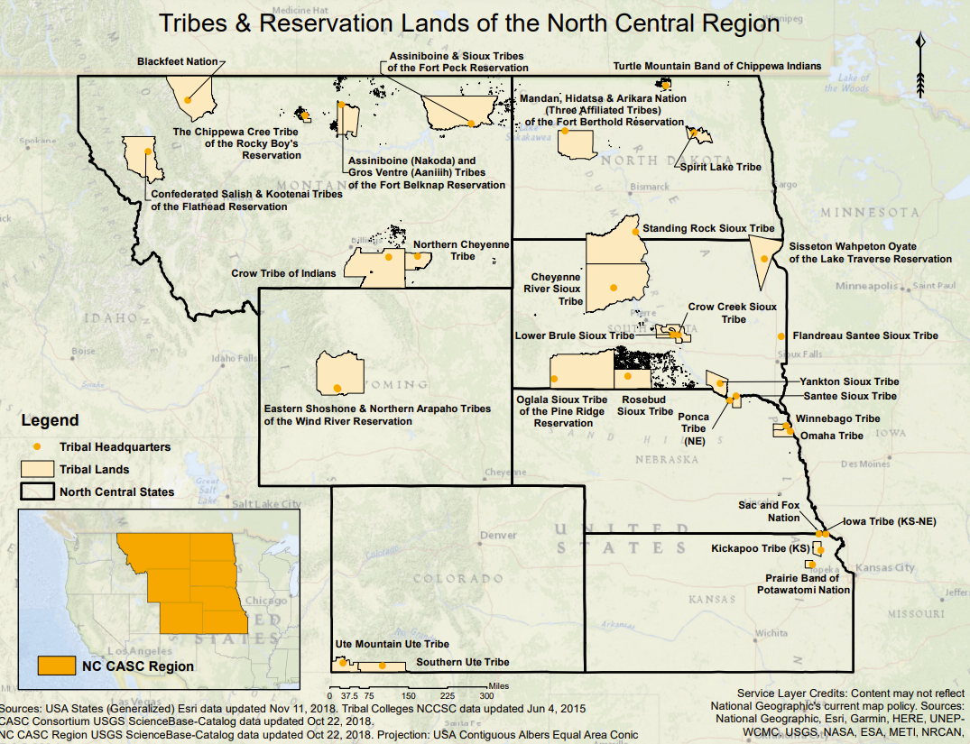
Regional Tribal Engagement Priorities
Our priorities are
Establish relationships
Support tribal communities for co-learning
Provide resources and capacity for tribal trainings
Help put tribal climate planning into climate action

Slide 10
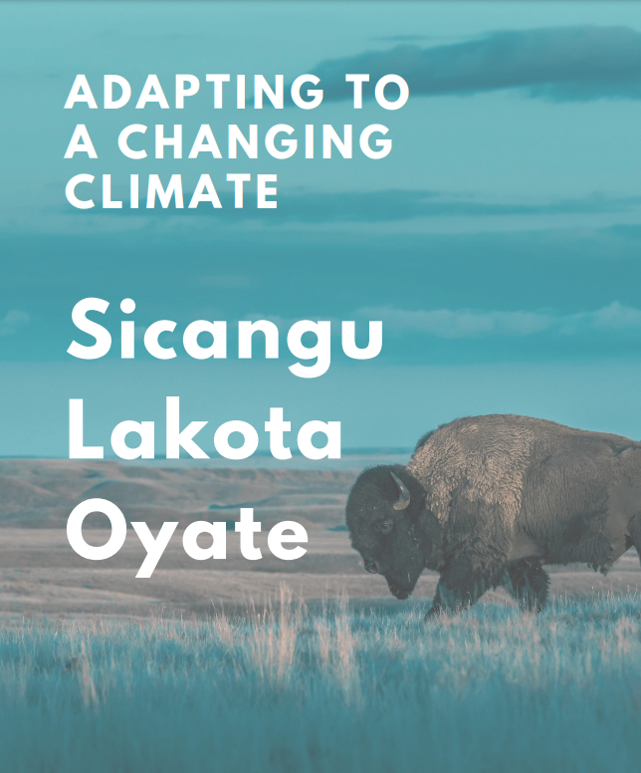
What we’ve done in the past:
We helped Rosebud Sioux Tribe with their plan on adapting to climate change by
Supporting grant writing process
Help to navigate planning process
Notes:
Work Phil twoeagle and Robin O’malley are the experts to talk to about this climate plan, we continue to be a resource

Slide 11
USGS-funded research projects:
Confederated Salish and Kootenai Tribes - How Institutional Context and Emotions Shape Manager Decisions about Ecosystem Transformation
Ute Mountain Ute Nation - Management and Restoration of Pinyon-Juniper in the Face of Changing Wildfire
Blackfeet Nation - Promoting Climate Resilience and Soil Health Through Bison and Cattle Grazing Management
Northern Cheyenne Tribe - Future Streamflow Estimates to Enable Water Management and Planning
If you’re interested in research around climate change issues- Ask us how you can apply for USGS funding!
Notes:
Emphasize we want to see more research projects on how cc impacts them on tribal lands // lots of tribes involved in projects and we have the funding to // by working with us we know whats impacting you and can help identify research projects // CSKT, we work with Mike Duraglo head of tribal historic preservation office.. how were parks going to manage these lands in high elevation pines

Slide 12
Future efforts:
We support tribal managers integrate climate adaptation into management efforts

Slide 13
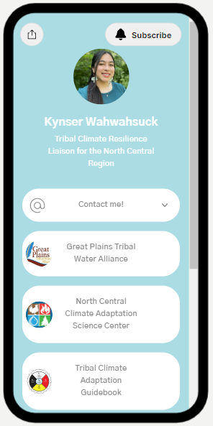
Scan QR code with your phone camera to view links
Contact me: kynser.wahwahsuck@colorado.edu
Subscribe to our Monthly Tribal Climate Adaptation Newsletter
Resources
Funding opportunities
Relevant news articles
Upcoming conferences and events

Slide 14
Resources:
Great Plains Tribal Water Alliance
North Central CASC
ITEP’s Tribal Adaptation Planning
Tribal Climate Adaptation Menu
Tribal Climate Adaptation Guidebook

