Slide 1
USGS-Tribal Cooperation and Long-Term Research Planning
Great Plains Tribal Water Alliance
2022 Fall Water Conference
Deadwood, South Dakota
November 16-17, 2023
Robert Lundgren
Hydrologist/ Tribal Coordinator
U.S. Geological Survey
Dakota Water Science Center

Slide 2
USGS Offices and Tribal Reservations in North and South Dakota

Slide 3
Tribal Coordinator Position
The Dakota Water Science Center (DWSC) created the Tribal coordinator position in 2019 to provide a single contact for Tribes and USGS cooperation
Tribal and Federal Partners
Tribes, BIA, EPA, etc.
Project Chiefs
Manages specific projects and cooperative agreements
Coordinates with DWSC Tribal coordinator to ensure efficiency and consistency
DWSC Tribal Coordinator
The “Go To” person
Coordinates questions between Tribes, Federal Partners and USGS

Slide 4
Current Tribal Activities
Completing groundwater well inventories
Expanding real-time groundwater monitoring networks
Continuing and expanding streamflow gaging networks
Tribal training in groundwater and surface water-quality data collection
Aquifer modeling, mapping, and scenario studies

Slide 5
On-going and Past Tribal Cooperation
Spirit Lake Tribe
Sampling program partnership since 1999
Three Affiliated Tribes
Independently collecting surface water-quality samples
Standing Rock Sioux Tribe
Groundwater and surface-water quality sampling
Rosebud Sioux Tribe
Leader in real-time groundwater monitoring program
Oglala Sioux Tribe
Expanding Streamflow gaging program
Yankton Sioux Tribe
Training in surface water-quality sampling

Slide 6
Tribal Long-Term Plan Matrix (with Proposed Research)
Tribal Name | (1) Groundwater Well Inventory | (2) Groundwater Level Monitoring Network | (3) Groundwater Mapping, Trends, or Modelling | (4) Streamflow Network | (5) Water-Quality Monitoring Program
 | Tribal Training
Cheyenne River Sioux Tribe | P |  |  | P
Flandreau Santee Sioux Tribe | P |  |  | P
Lower Brule Sioux Tribe |  |  |  | P
Oglala Sioux Tribe | P | P | P | P | P
Rosebud Sioux Tribe | P | P | P | P
Spirit Lake Tribe | P | P |  | P | P
Standing Rock Sioux Tribe | P |  | In progress | P | P
Sisseton-Wahpeton Oyate | In progress | P | P | P | P
Three Affiliated Tribes |  | P |  | P | P
Turtle Mountain Band of Chippewa Indians |  | P | In progress | P
Yankton Sioux Tribe | In progress |  |  | P | In progress

Slide 7
(1) Groundwater Well Inventory – Suggestions
Review and update well databases to ensure accuracy
Tribal engagement is critical for finding, visiting, cataloging locations
USGS assists and provides training during inventory processes
Inventory processes build tribal capacity for groundwater data collection

Slide 8
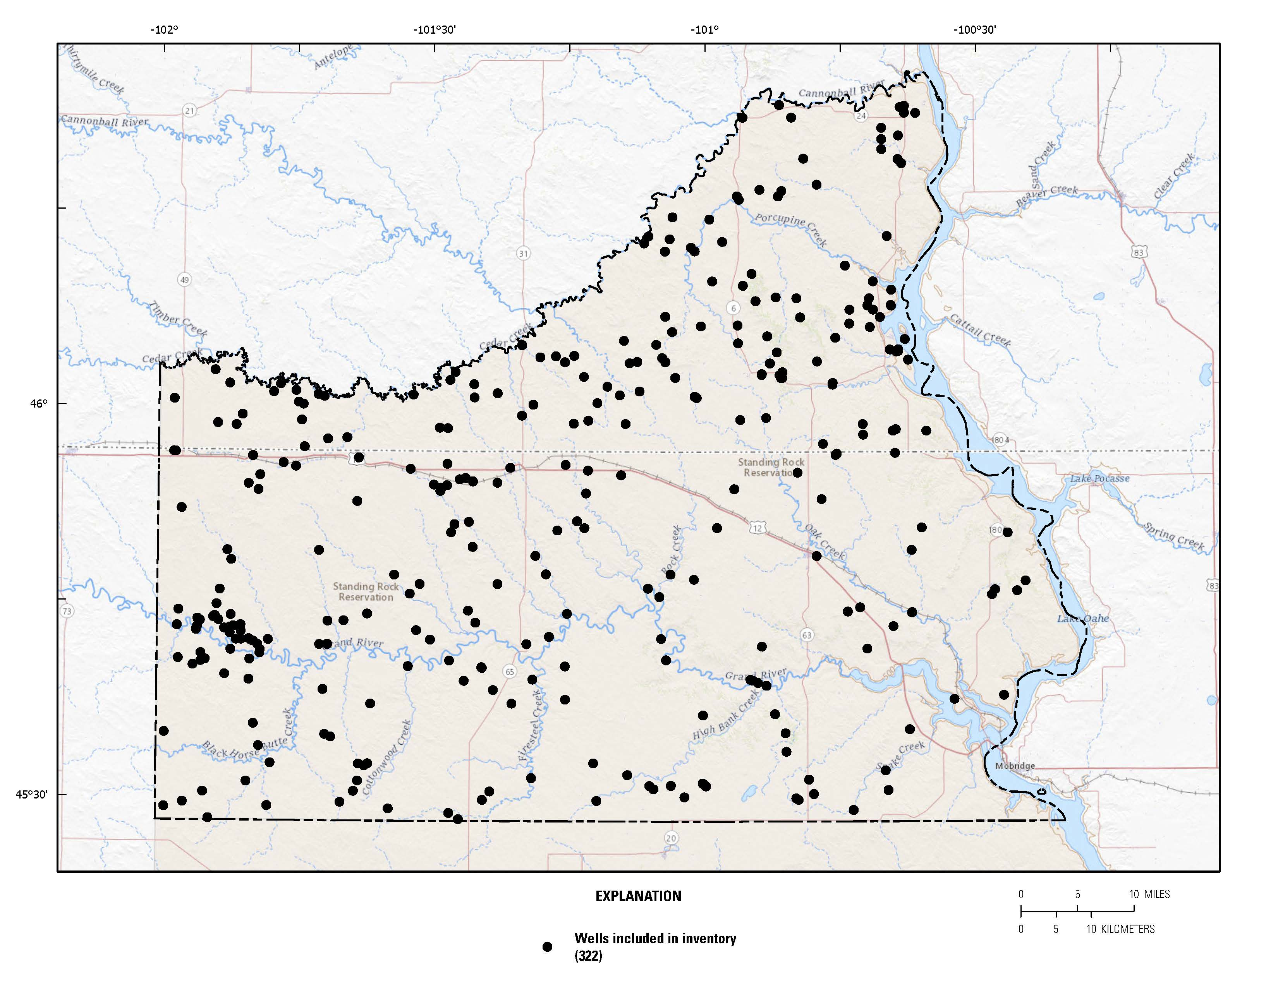
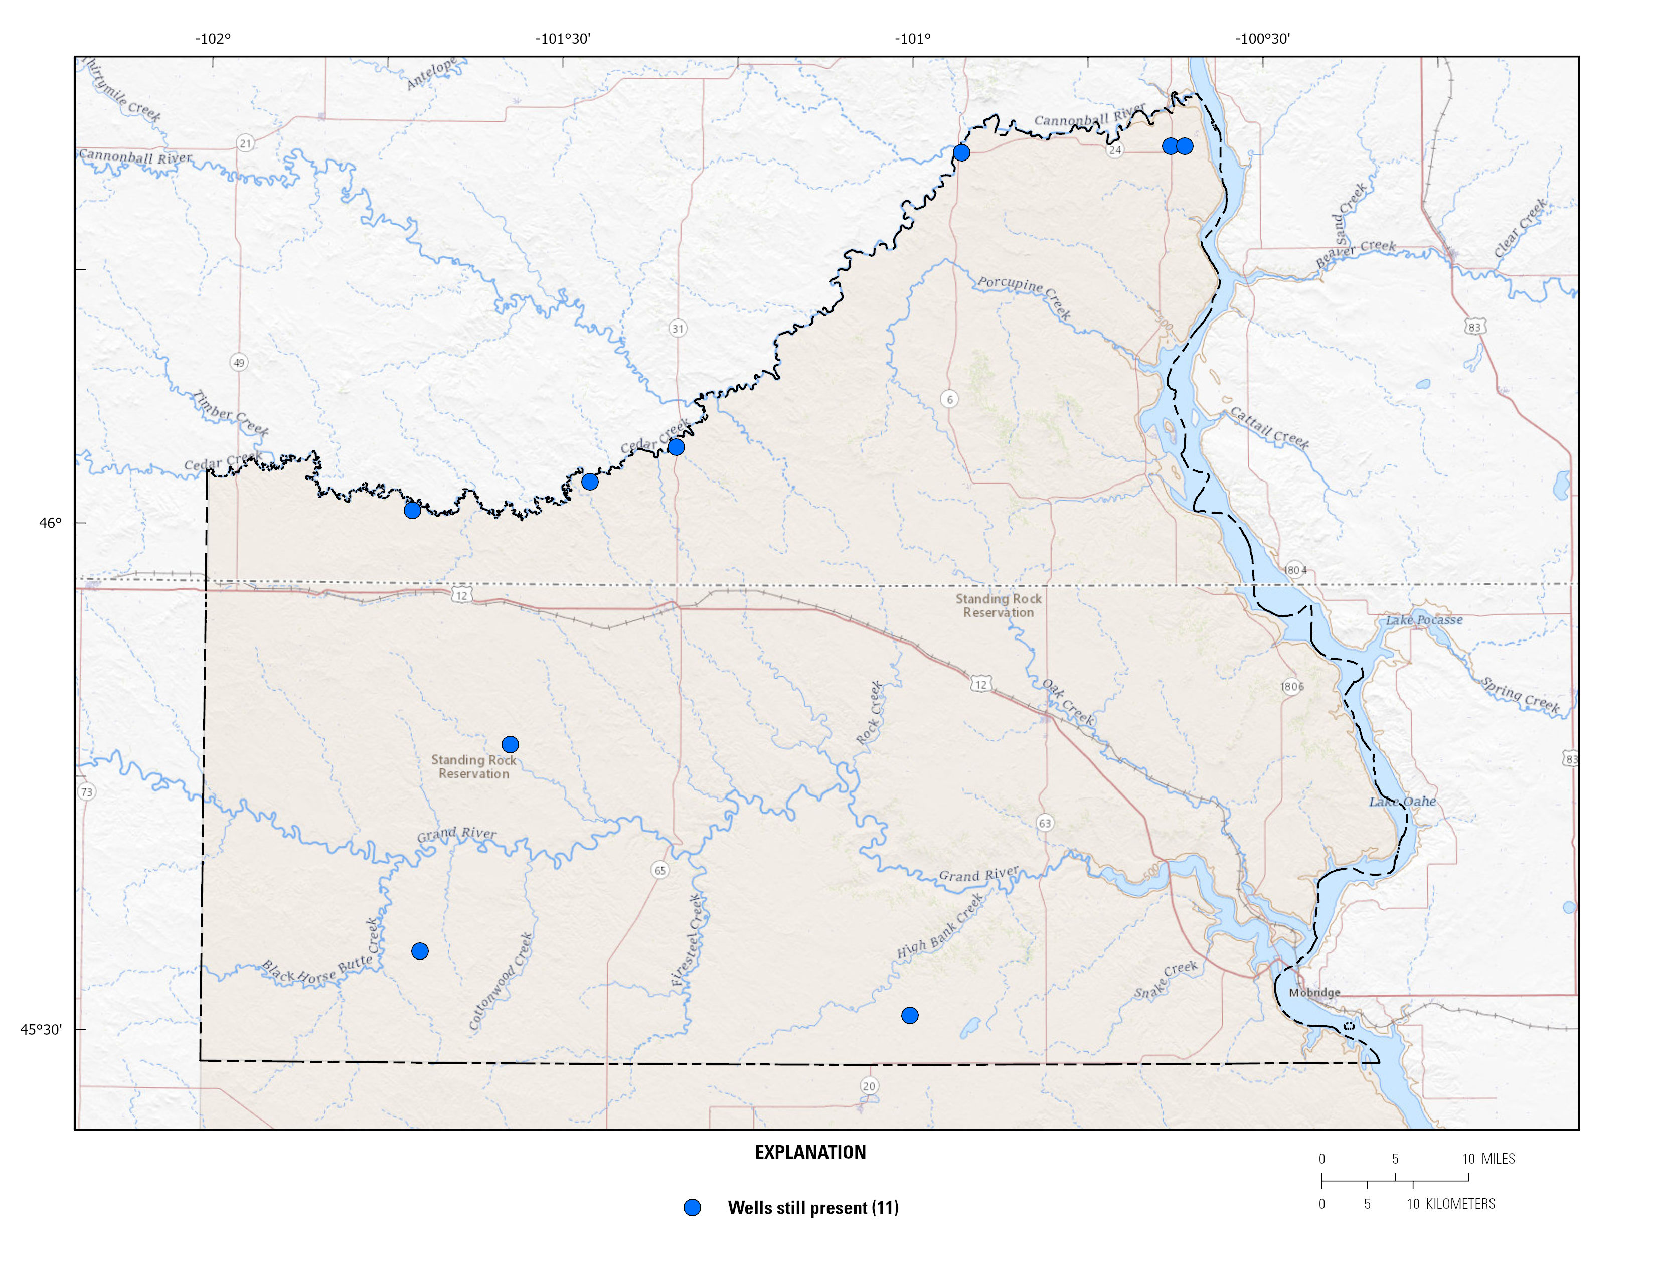
Standing Rock Wells Inventory (Inventory improved database by removing reclaimed or destroyed wells)
Before Wells Reconnaissance
After Wells Reconnaissance

Slide 9
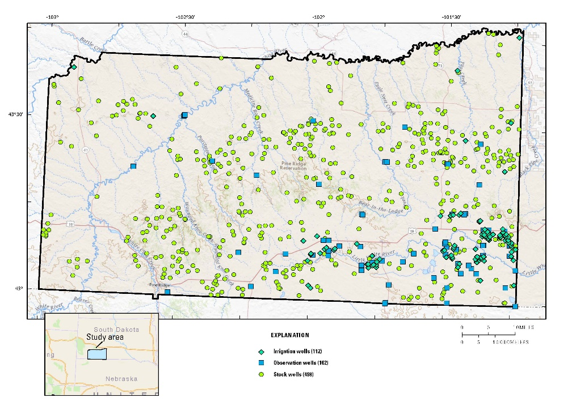
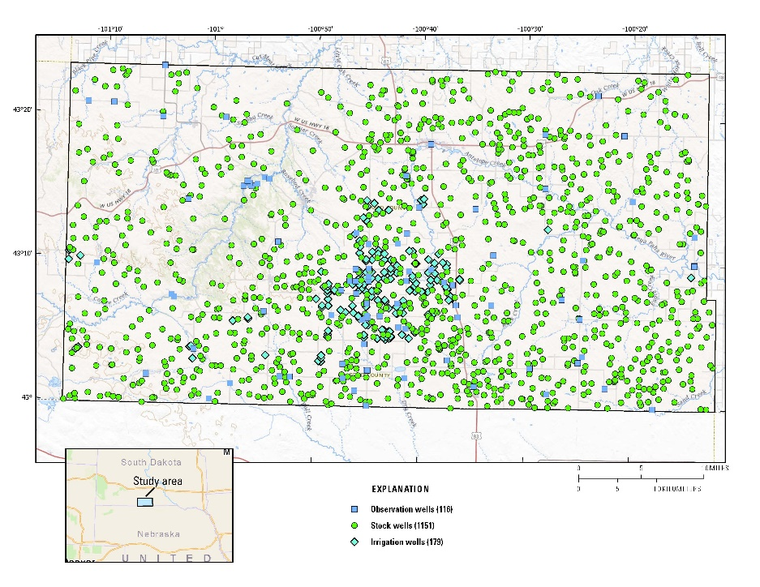
Proposed Groundwater Well Inventories (Current wells in databases)
Pine Ridge Reservation Wells
Rosebud Reservation Wells

Slide 10
(2) Groundwater Level Monitoring Network - Suggestions
Assess current monitoring well network
Understand tribal concerns about groundwater resources
Instrument wells for measuring and recording water levels/water quality
Discern potential effects of water use and climate fluctuations
Determine trends over long time periods
Build tribal capacity for groundwater data collection

Slide 11
(3) Groundwater Mapping and Modeling - Suggestions
High Plains Aquifer Model is being developed
Utilize the groundwater flow model to better understand upgradient impacts on water resources on the Reservation
Update or construct potentiometric maps of aquifers
Construct and use groundwater flow models to understand effects of system changes on groundwater availability and flow
Model direction of groundwater flow and sources of recharge to wells

Slide 12
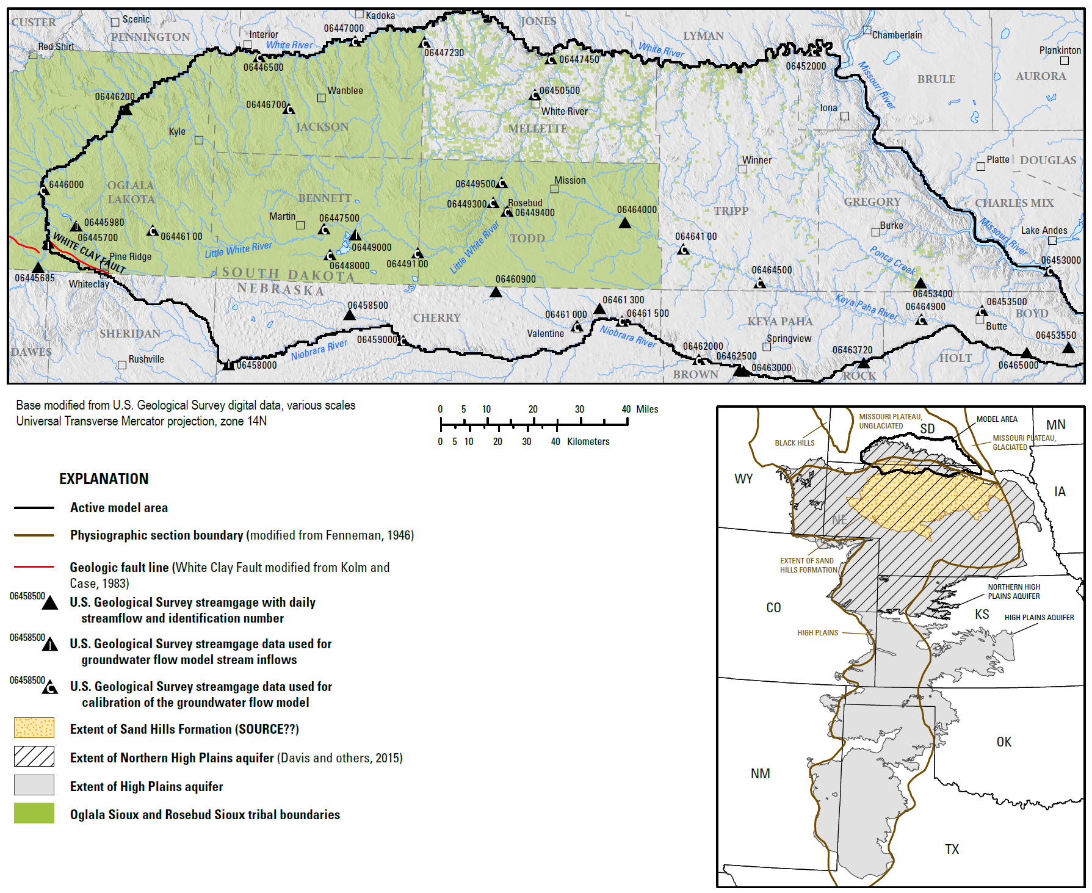
(3) Groundwater Mapping and Modeling – Suggestions (cont.)
High plains aquifer is important to Oglala and Rosebud Sioux tribes
Aquifer used for drinking water, agriculture, and influences streamflow
Model provides better understanding of the groundwater-flow system and connection with surface water
Model can estimate groundwater flow paths & water-levels in drought conditions

Slide 13
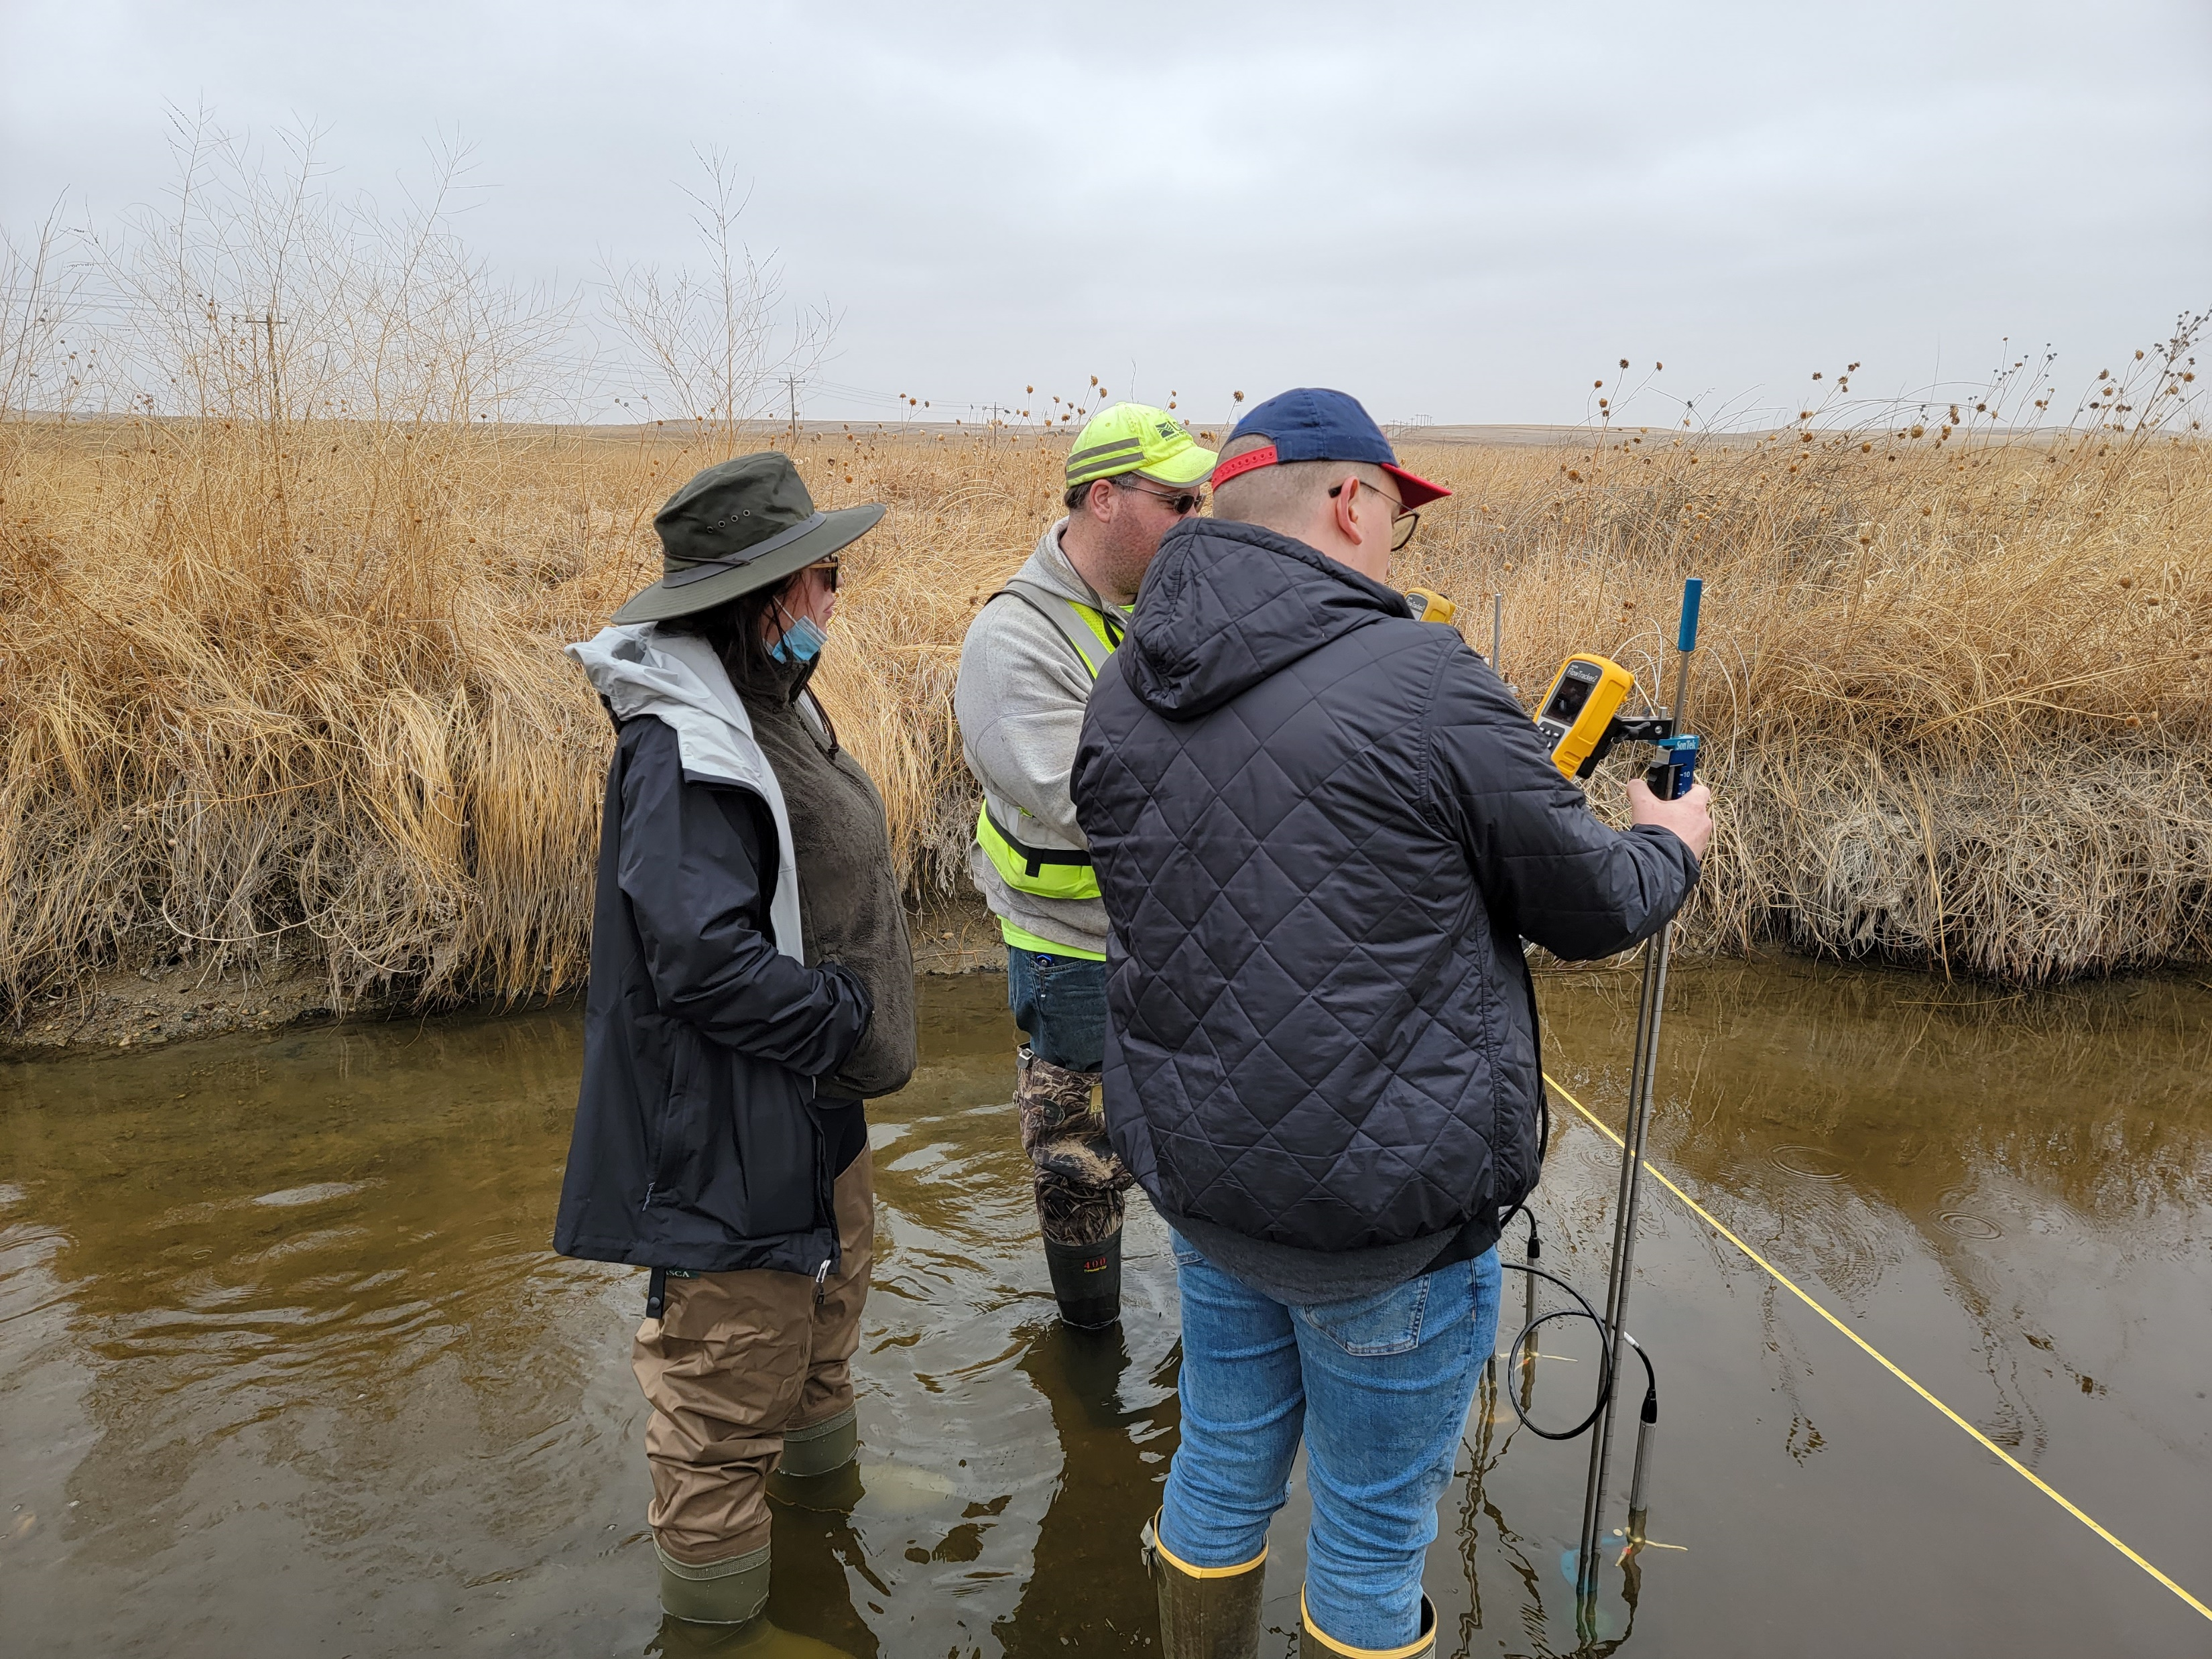
(4) Streamflow Network- Suggestions
Continue long-term streamflow data collection
Monitor changes in streamflow from land use, climate change
Work with tribes to determine additional gage locations
Build tribal capacity
for streamflow
measurements

Slide 14
(5) Water-Quality Monitoring Program - Suggestions
Develop a long-term GW and SW quality monitoring program to understand water resources on the Reservation
Train and develop tribal capacity for collecting, monitoring, and analyzing water quality
Understand tribal concerns for water quality—develop new sites to adapt to changing conditions

Slide 15
Proposed Cooperative Research and Data Collection Activities
Groundwater well inventories
Real-time groundwater monitoring
Continued streamflow monitoring
Discussions about real-time uranium monitoring on Cheyenne River (via surrogate constituents)
Discussion to determine indirect and artificial recharge

Slide 16
Proposed Cooperative Research and Data Collection Activities, cont.
Bottom line, need more data collection for climate change adaptation studies

Slide 17
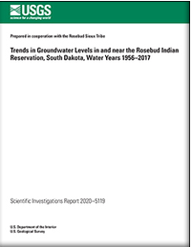
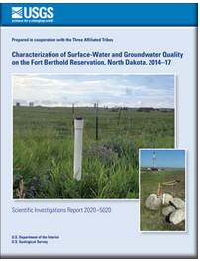
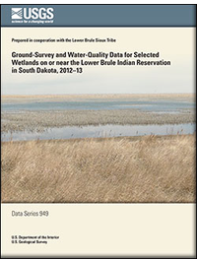
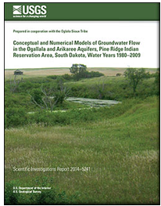
USGS Publications with Tribal Cooperation
Publications are documented, citable, and readily available on-line
https://pubs.er.usgs.gov

Slide 18
Questions?

